Slide 1
Title: Sales Forecasting
for Small Basket
Ayan Maity
Batch - 86
Student ID - 3845

Slide 2
Problem Statement
Small Basket is a huge online / mobile application-based grocery retailer in India, founded in 2011. Small Basket is trying to manage its supply chain and delivery partners and would like to accurately forecast the sales for the period starting from January of 2019 to August
of 2019. You are also given a few features that were developed by the Business Intelligence team, that might or might not provide additional insights to your analysis.
Problem objective
Our objective is to create a model that can accurately forecast the
sales for small basket across several locations and product categories.

Slide 3
Why Sales Forecasting ?
Improve on shelf availability. Avoid Backorder.
If the product is out of stock then it leads to loss.
There is also moderate amount of products that are perishable, their quality decline over time and expire after a certain date.
There is huge competition. To keep up with the fluctuating customer demand we need robust supply chain management.

Slide 4
Dataset Overview
Dataset | Features
train.csv | Date, locationId, item_id, unit_sales, onpromotion
train_transactions.csv | Date, location_identifier, transactions
items.csv | Item_id, category_of_items, class, perishable
locations.csv | Location_id, city, state, type, cluster
test.csv | Id, date, locationId, item_id, onpromotion

Slide 5
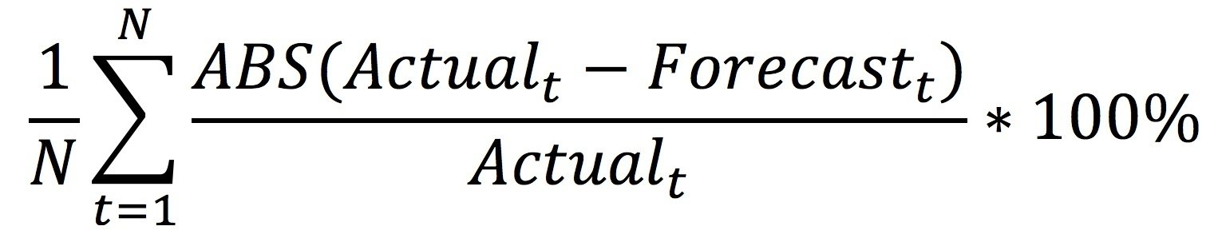
Classifying the problem statement.
Forecast no of sales for a given item for the dates given in test.csv.
We are looking at a Time Series data at an item and location level.
Error Metric
MAPE ( Mean Absolute Percentage Error )

Slide 6
Exploratory Data Analysis.

Slide 7
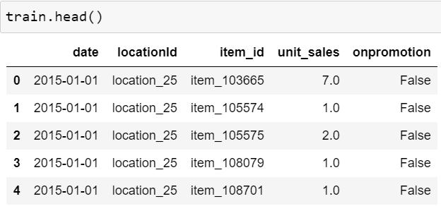
train.csv
Training data includes unit sales by date, location_id and item_id. An additional onpromotion column is there to indicate that the given product sold was in a promotion or discount.

Slide 8
train.csv
There are 101688779 rows and 5 columns in the train data.
The target feature (unit_sales) can be integer ( 2 bottles of soft drink ) or float ( 200g flour )
There are negative values in the target feature, which may indicate return of that particular item.
There are missing values in the onpromotion column.
We have data for past 4 years starting from 01/01/2015 - 31/12/2018.

Slide 9
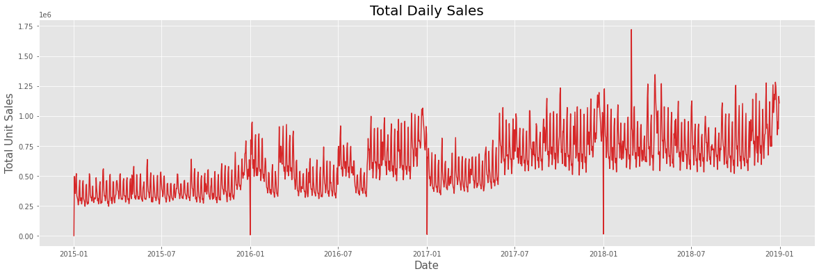
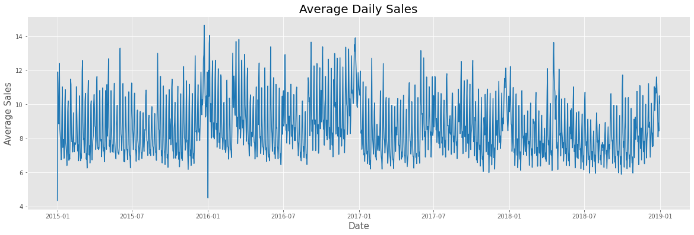
Total Sales over time (daily).
Average Sales over time (Daily)

Slide 10
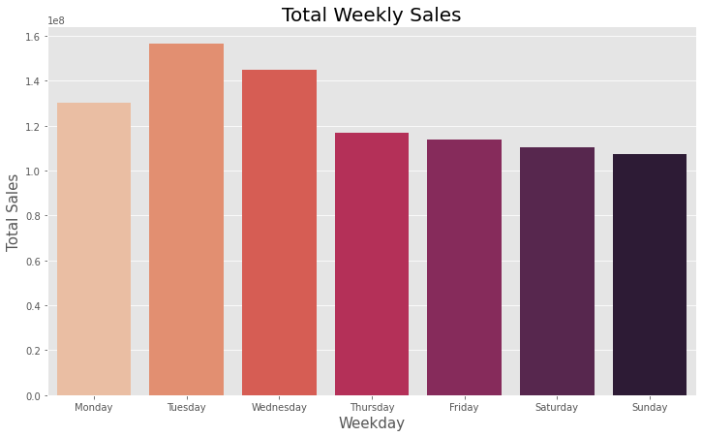
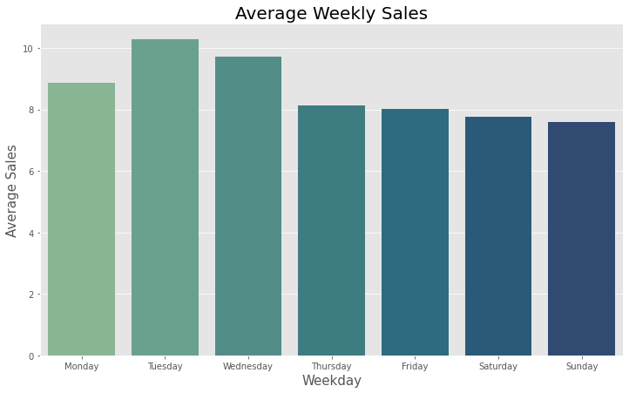
Average sales weekday basis.
Total sales weekday basis.

Slide 11
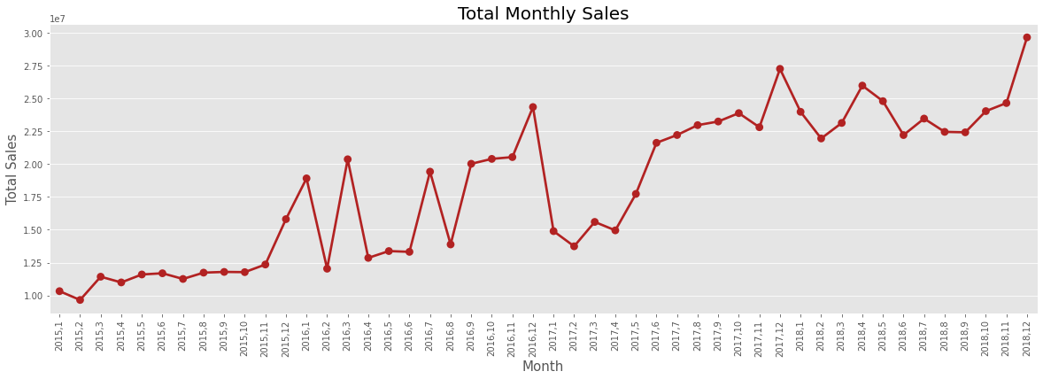
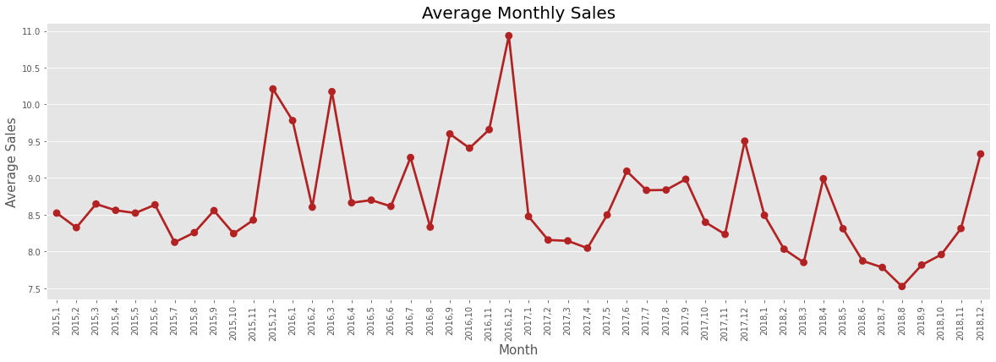
Total Sales over time (Monthly).
Average Sales over time (Monthly).

Slide 12
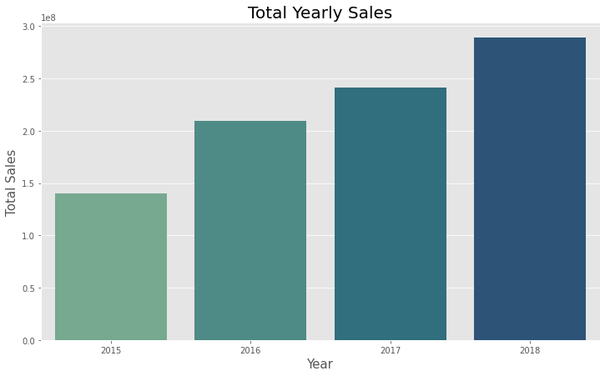
Total Sales over time (yearly).

Slide 13
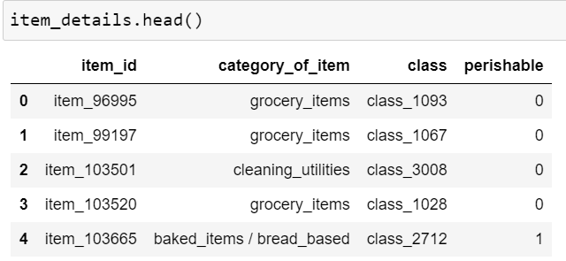
Item Data
Item data includes item_id ( An identifier of a product ), category_of_item ( the category to which the product belongs to ), class( Another way to classify product ), perishable(Whether the item is perishable or not).

Slide 14
Item data
There are 4100 unique number of products.
There are 30 unique categories of item.
There are 337 unique classes.

Slide 15
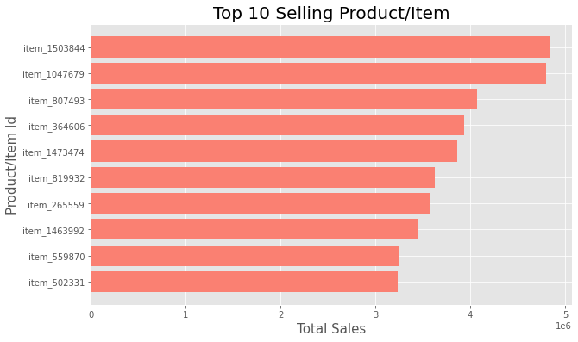
Top 10 selling products.

Slide 16
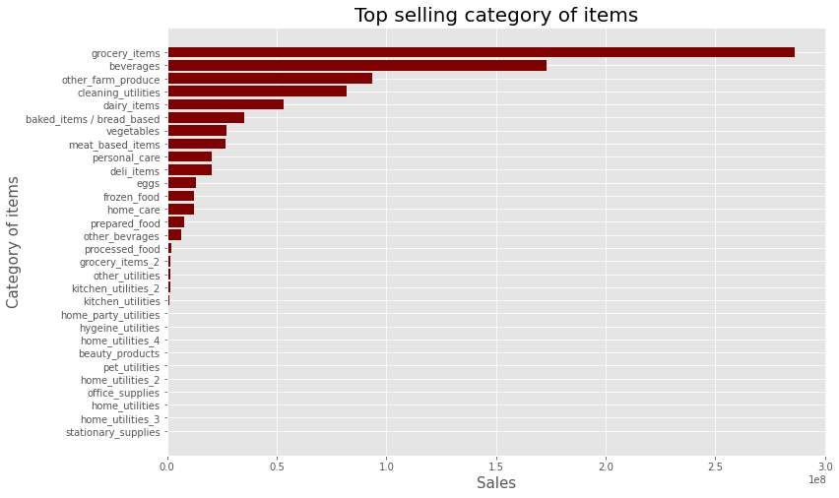
Top selling categories.
Grocery items , beverages , other farm produce, cleaning utilities, dairy items are the top selling categories.

Slide 17
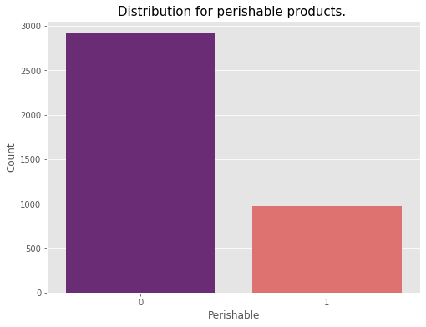
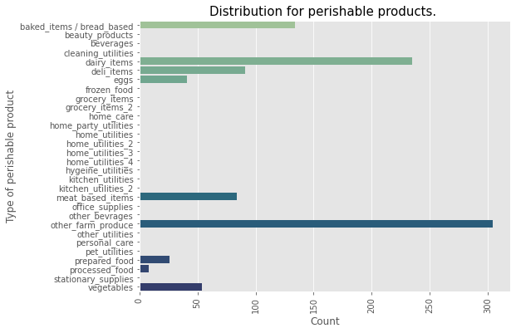
Majority of the items are non perishable.
Top 5 Perishable Foods are
Other Farm Produce
Dairy Items
Baked Items / Bread Based
Deli Items
Meat Based Items

Slide 18
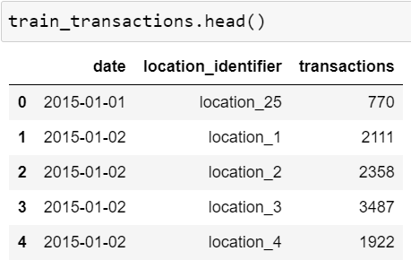
Transaction data
Transaction data includes date, location_identifier ( The location from where the transactions were handled ) , transactions ( The number of transactions handled by the particular location )

Slide 19
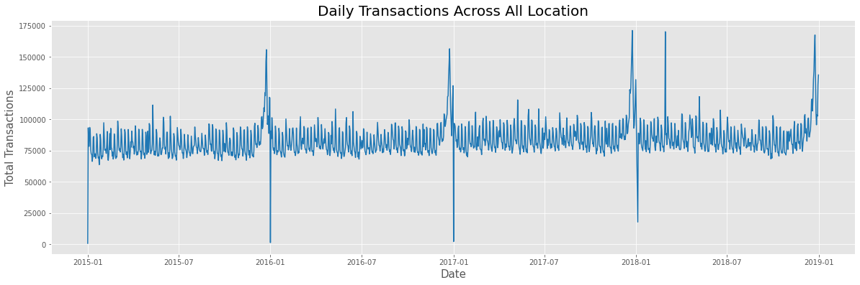
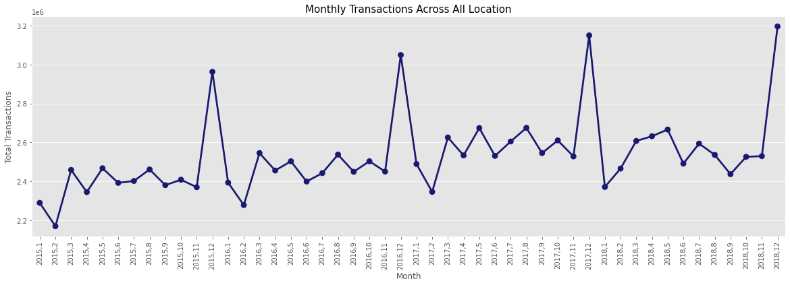
Daily transactions across all location
Monthly
transactions across all location

Slide 20
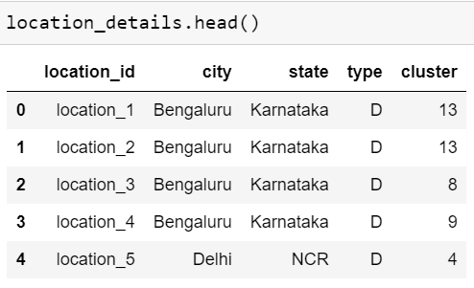
Location data.
Location data includes location_id ( The location of the store / warehouse ),city (The city where the unit is located ), state ( The state in which the city is located), type ( The type of business unit (‘A’, ‘B’, ‘C’, ‘D’, ‘E’)) , cluster (The cluster that the unit belongs to )

Slide 21
Location data
There are 54 unique stores across all India.
They operate in 13 states and 22 cities.
There are 5 different types of business units (‘A’, ‘B’, ‘C’, ‘D’, ‘E’).
There are 17 different types of clusters. (1-17)

Slide 22
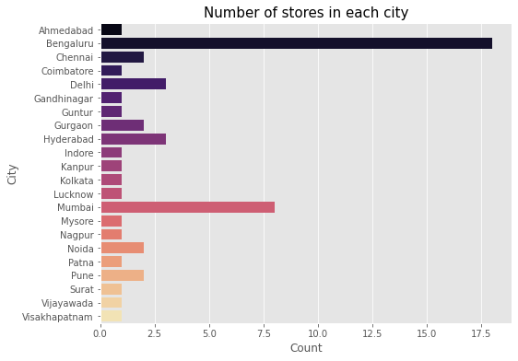
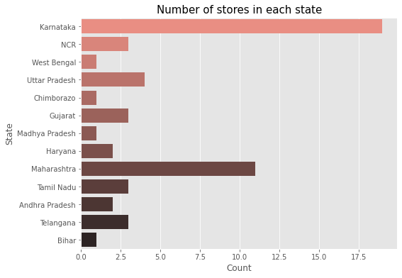
Count of stores in each city ,state.
Top States with majority of the store units are:
Karnataka
Maharashtra
Uttar Pradesh
Telangana
Tamil Nadu
Top cities with majority of the store units are:
Bengaluru
Mumbai
Hyderabad , Delhi

Slide 23
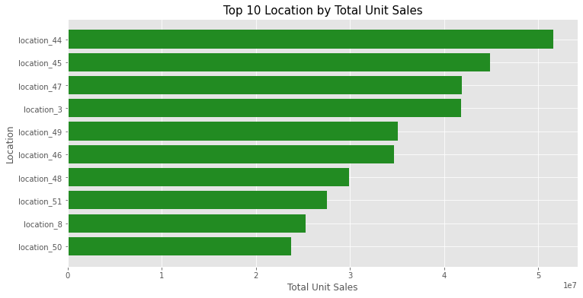
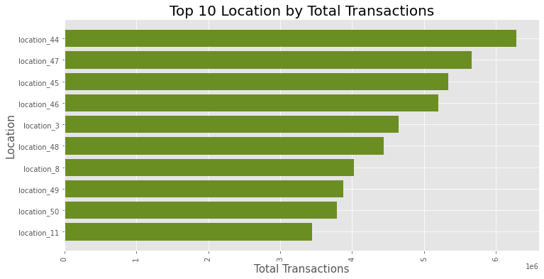
Top 10 location with highest unit sales.
Top 10 location with highest transactions.

Slide 24
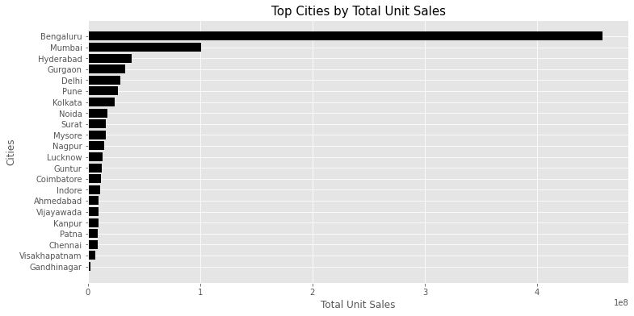
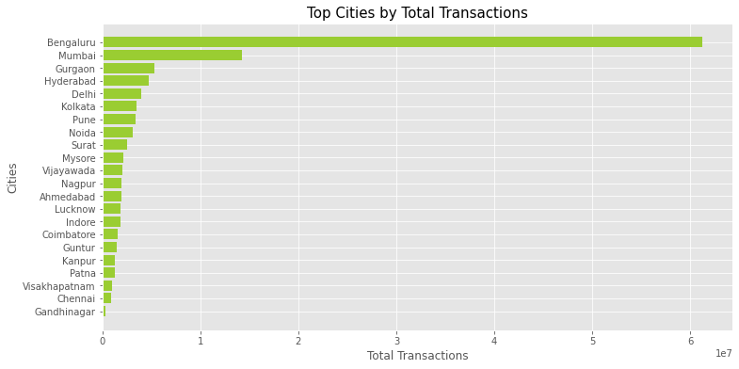
Cities with total unit sales.
Cities with total transactions.

Slide 25
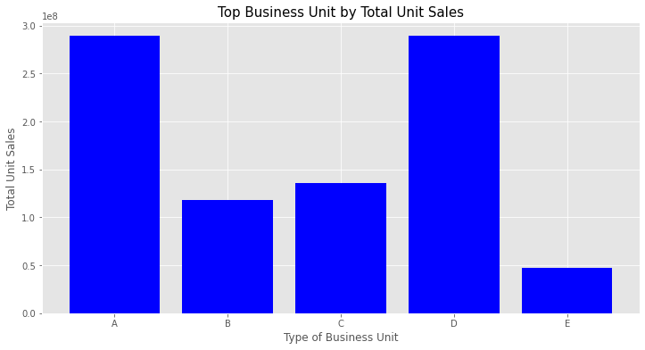
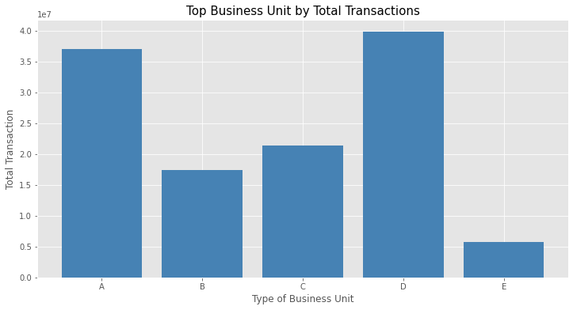
Business units with total unit sales.
Business units with total transactions.

Slide 26
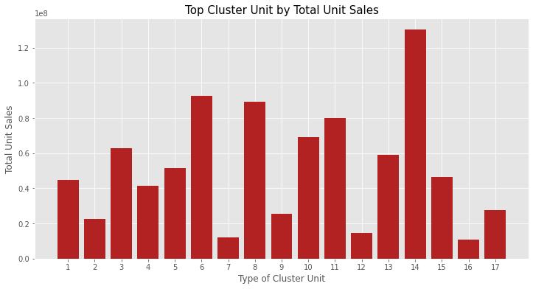
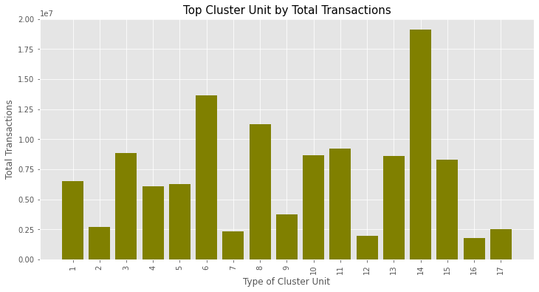
Clusters with total unit sales.
Clusters with total transactions.

Slide 27
EDA Final Thoughts.
There’s an upward trend in year by yearly total unit sales. Which is a good indication that the sales are growing.
Amount of transactions increases during the year end seasons.
Even the total number of store units are 54 among them few stores have high amount of sales.
Bangalore is an important location, both in terms of total unit sales and total transactions.
Unit “A” and “D” generate most profit for the company.
Cluster no. belonging to 14,6,8 shows maximum sales and transactions.

Slide 28
Predictive Analytics

Slide 29
Challenges
Since our training data is large in size, its difficult to perform preprocessing activities. So from now on we’ll work with only a subset of data. Since our test data contains dates ranging from 01/01/2019-15/08/2019, we’ll try to build our model only with the previous year data where date ranging from 01/01/2018-15/08/2018.
Although we have a time series problem, but since there are multiple instances of the same date it’s difficult to figure out the time series model/algorithm for this problem. To overcome this issue, we’ll try regression method with time features to build our models.
‘item_id’ is a categorical variable with high cardinality. And There are 4018 distinct items in test. There are 3663 distinct items in train. There are 3646 items common in train and test. There are 372 items only in test data (not in train.) These items represent about 6.01% of test data. Will have to deal with these new items.

Slide 30
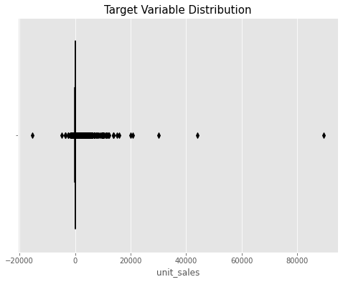
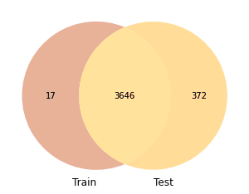
Challenges
Item distribution in train and test

Slide 31
Experiment 1
Data Preprocessing:
Loading train, item_details,location_details data.
Merging item and location data with train using left join.
Extracting date,month,week from the date column.
Dropping date and the features with high cardinality i.e. item_id, class from the dataframe.
Removing negative unit_sales.
Label Encoding all the columns except the target variable.
Converting all columns into category expect the target variable.
Splitting the data into train and validation set.
Log transforming the target variable.

Slide 32
Experiment 1
Model Building:
Applied Random Forest Regression and Gradient Boost Regression on the prepared dataset.
Predicted on the test data.
Results:
Model | Model Performance (Mape)
Random Forest Train (Without Log) | 160.17869842229744
Random Forest Test (Without Log) | 163.00
Gradient Boost Train | 109.97420120515697
Gradient boost Test | 119.15

Slide 33
Experiment 2
Data Preprocessing:
Loading train, item_details,location_details data.
Merging item and location data with train using left join.
Extracting date,month,week from the date column.
Dropping date and the features with high cardinality i.e. item_id from the dataframe.
Removing negative unit_sales.
Removed outliers using IQR.
Label Encoding all the columns except the target variable.
Converting all columns into category expect the target variable.
Splitting the data into train and validation set.
Log transforming the target variable.

Slide 34
Experiment 2
Model Building:
Applied LGBM (Light GBM) on the prepared dataset.
Predicted on the test data.
Results:
Model | Model Performance (Mape)
LGBM Train | 82.58407165058243
LGBM Test | 86.12

Slide 35
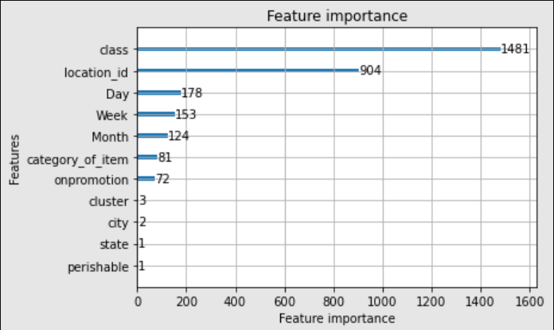
Experiment 2
Feature Importance for Experiment 2

Slide 36
Experiment 3
Data Preprocessing:
Loading train, item_details data.
Merging item data with train using left join.
Extracting date,month,week from the date column.
Dropping date and perishable column from the data.
Removing negative unit_sales.
Removed outliers using IQR.
Converting all columns into category expect the target variable.
Splitting the data into train and validation set.
Log transforming the target variable.

Slide 37
Experiment 3
Model Building:
Applied LGBM (Light GBM) with
boosting_type= 'dart', # rf,goos,gbdt
num_leaves = 31,
objective = 'regression_l1', # l2,mape
max_depth = 8, #3,4,5,7
min_data_in_leaf = 50, #10,20,20,80
learning_rate = 0.01, # 0.1,0.05,0.001
metric = 'l1' # l2,mape
Predicted on the test data.

Slide 38
Experiment 3
Results:
Model | Model Performance (Mape)
LGBM Train | 56.40810836436047
LGBM Test | 60.24

Slide 39
Experiment 4
Data Preprocessing:
Loading train, item_details data.
Merging item data with train using left join.
Extracting date,month,week from the date column.
Dropping date and perishable column from the data.
Removing negative unit_sales.
Removed outliers using IQR.
Converting all columns into category expect the target variable.
Log transforming the target variable.

Slide 40
Experiment 4
Results:
Model | Model Performance (Mape)
LGBM Train | 56.36846
LGBM Test | 59.89

Slide 41
Other experiments:
Categorical embeddings with single hidden layer. Test Mape - 64.
Generated nonlinear features with autoencoders and then added those feature to improve LGBM model.
LGBM model with different subset of data.
Added new items in the train data along with 0 for unit sales.

Slide 42
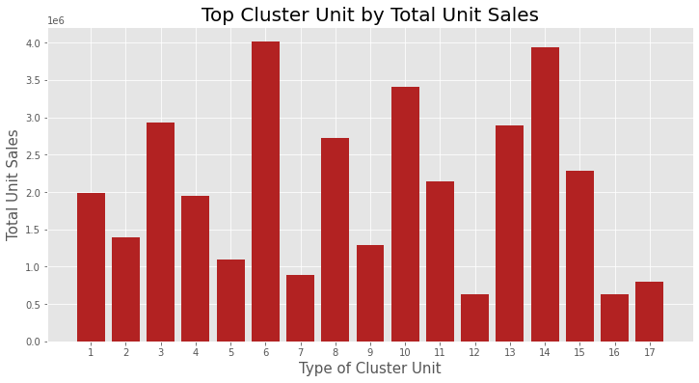
Answering questions from operations team.
Question : Business units belonging to which cluster will see the highest amount of sales in 2019 ?
Answer: Cluster 6

Slide 43
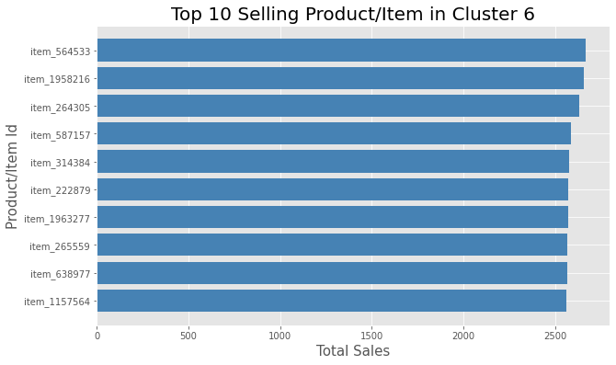
Answering questions from operations team.
Question : What are the top selling items in this cluster.
Answer: These are the top selling products in that cluster.

Slide 44
Future Work
Add more layers with categorical embeddings and check model performance.
Add time series related features with the training data and check model performance.
Handle new items in test data for more explainability.

Slide 45
References:
https://medium.com/bigdatarepublic/advanced-pandas-optimize-speed-and-memory-a654b53be6c2
https://towardsdatascience.com/understanding-lightgbm-parameters-and-how-to-tune-them-6764e20c6e5b?gi=e8c09744e86d
https://www.fast.ai/2018/04/29/categorical-embeddings/
https://lightgbm.readthedocs.io/en/latest/Parameters.html
https://arxiv.org/abs/1505.01866

Slide 46
Thank You
Ayan Maity

